Slide 1
Introduction to Cloud Data Analytics

Slide 2
Outline
Machine Learning Based Cloud Analytics
Activities in this course
Overview of Data and Data Analytical Tasks Reviewed in this Course

Slide 3
Data Analytics
The process of discover meaningful patterns in data
Raw data by themselves may not be too useful nor interesting
It is our task to make sense of the data and discover meaningful patterns
Student ID | Study Time | Sleep Time | Grade
001 | 5 | 8 | 3
002 | 8 | 5 | 3.6
003 | 3 | 11 | 2.2
004 | 4 | 8 | 2.4
005 | 1 | 6 | 1.2
006 | 7 | 8 | 3.75
007 | 6 | 7 | 3.1
$$grade=0.297+0.38t_{study}+0.081t_{sleep}$$
***This is a toy example and neither the data nor the result are from actual studies

Slide 4
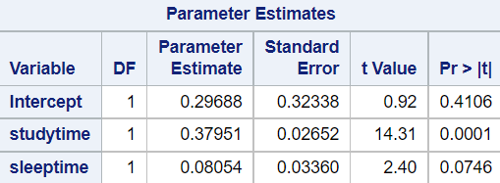



Machine Learning Based Data Analytics
Traditional analytical methods like statistical models typically requires a lot of monitoring and controls from the analysts
Machine learning analytics refers to the use of algorithms that can automatically learn from data to solve a given task
That is not to say they are 100% automated. We as the analysts still need to involve in the process
That is also not to say that traditional methods are irrelevant at this moment. They do have their roles in data analytics. They just aren’t the focus of this course
Machine learning models can continue learning to adapt to new data
Student ID | Study Time | Sleep Time | Grade
001 | 5 | 8 | 3
002 | 8 | 5 | 3.6
003 | 3 | 11 | 2.2
004 | 4 | 8 | 2.4
005 | 1 | 6 | 1.2
006 | 7 | 8 | 3.75
007 | 6 | 7 | 3.1
Traditional
Analytics
Machine Learning
Analytics
Fit a regression model:
$$grade=0.297+0.38t_{study}+0.081t_{sleep}$$
Determine a suitable ML algorithm for the data
For example, neural network
Statistical tests suggest that $t_{sleep}$ is not significant
Determine a suitable ML algorithm for the data
For example, neural network
Fit new model without $t_{sleep}$:
$$grade=1.001+0.36t_{study}$$
Finetuning and Training are automated
→ Obtain and deploy trained model
New data comes
→ repeat most (if not all) of the process
New data comes
→ Continue training the deployed neural network
008 | 2 | 4 | 3.1
009 | 9 | 4 | 3.2
008 | 2 | 4 | 3.1
009 | 9 | 4 | 3.2

Slide 5





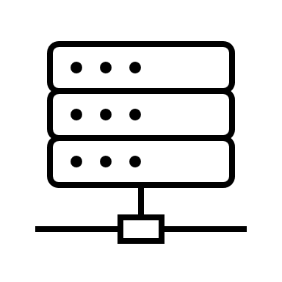

Machine Learning Based Data Analytics on Clouds
In short, cloud technologies move computational resources (including both software and hardware) outside of the local environment
Many machine learning algorithms are computationally expensive more than what a regular personal computer may provide
On the other hand, there are multiple cloud services offering resources for analytics
In this course, we focus on Amazon Web Services and Microsoft Azure
The two services provide many options for specific tasks in analytics. We will focus on the more general machine learning options:
SageMaker on AWS
Machine Learning on Azure
Both utilize Python to write script, so we will start with reviewing Python programming

Slide 6
Analytical Tasks Reviewed in this Course
Classification
Regression
Anomaly detection
Forecasting
Image Analytics
Text Analytics

Slide 7
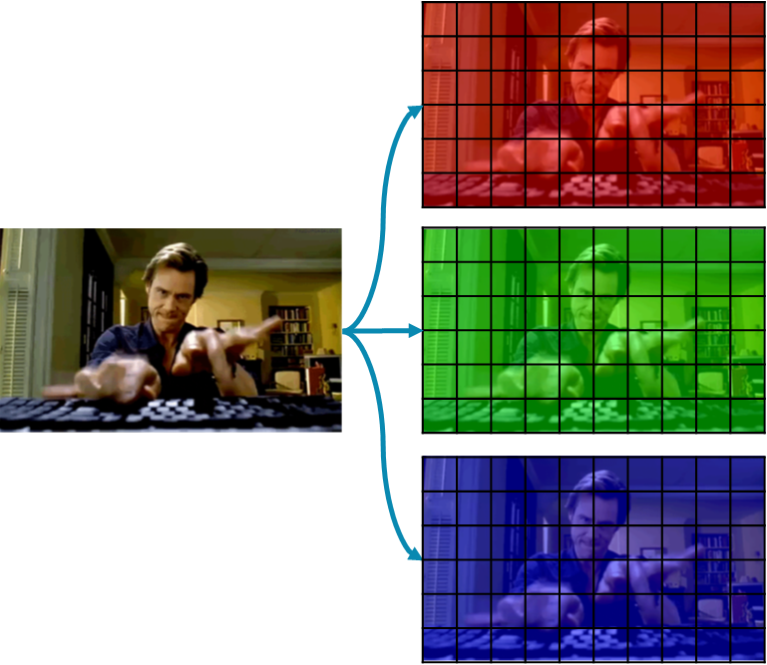
Common Types of Data
Student ID | Study Time | Sleep Time | Grade
001 | 5 | 8 | 3
002 | 8 | 5 | 3.6
003 | 3 | 11 | 2.2
004 | 4 | 8 | 2.4
005 | 1 | 6 | 1.2
006 | 7 | 8 | 3.75
007 | 6 | 7 | 3.1
Tabular data
Usually in the form of a 2-Dimensional table (e.g., in Excel or regular DBMS)
Rows represent individual instances or data points
Columns represent features
Image data – are 3D tensors
One image instance is one 3D tensor
Each element in the tensor represents the magnitude of the corresponding pixel at the width/height location and color channel
Text data – are …texts
Usually referred to as unstructured data
One instance can be one sentence, one paragraph, or one document
Need to be transformed into numeric before modeling
Each row represent one individual student
Each column represent one type of information
5 | 1 | 3 | 8 | 9
1 | 0 | 0 | 8 | 1
0 | 7 | 5 | 3 | 1
8 | 2 | 5 | 9 | 8
5 | 1 | 3 | 8 | 9
1 | 0 | 0 | 8 | 1
0 | 7 | 5 | 3 | 1
8 | 2 | 5 | 9 | 8
5 | 1 | 3 | 8 | 9
1 | 0 | 0 | 8 | 1
0 | 7 | 5 | 3 | 1
8 | 2 | 5 | 9 | 8
It was the best of times, it was the worst of times, it was the age of wisdom, it was the age of foolishness, it was the epoch of belief, it was the epoch of incredulity, it was the season of Light, it was the season of Darkness, it was the spring of hope, it was the winter of despair, we had everything before us, we had nothing before us, we were all going direct to Heaven, we were all going direct the other way—in short, the period was so far like the present period, that some of its noisiest authorities insisted on its being received, for good or for evil, in the superlative degree of comparison only.

Slide 8
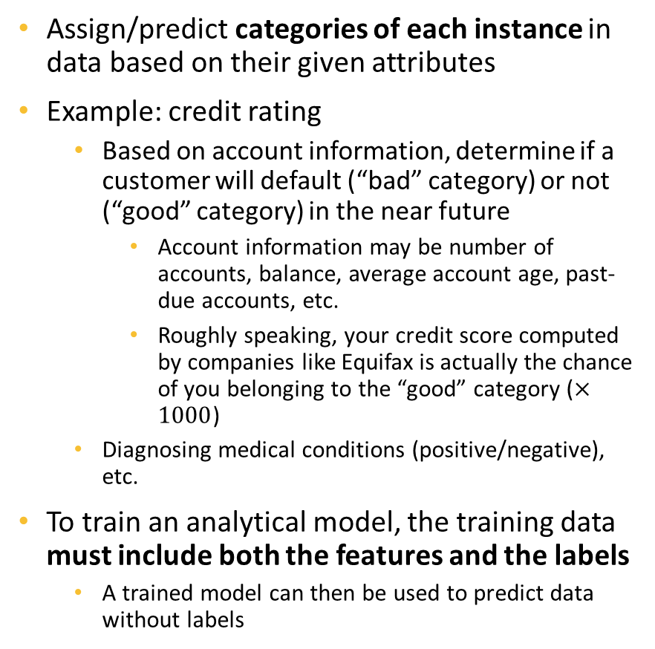
Classification
Enc_SSN | NoOfAcc | Balance | 3MnPstDue | 6MnPstDue
Ad9asgvjabl | 3 | 100 | 0 | 0
CLvb0das9b | 1 | 2500 | 1000 | 500
MCdfasd924 | 4 | 50 | 0 | 0
Mx9ta9fgak4 | 2 | 1200 | 200 | 0
Ro04ik2lv90 | 4 | 200 | 50 | 0
Class
Good
Bad
Good
Good
Good
Assign/predict categories of each instance in data based on their given attributes
Example: credit rating
Based on account information, determine if a customer will default (“bad” category) or not (“good” category) in the near future
Account information may be number of accounts, balance, average account age, past-due accounts, etc.
Roughly speaking, your credit score computed by companies like Equifax is actually the chance of you belonging to the “good” category ($×1000$)
Diagnosing medical conditions (positive/negative), etc.
To train an analytical model, the training data must include both the features and the labels
A trained model can then be used to predict data without labels
Must provide both to train models
Enc_SSN | NoOfAcc | Balance | 3MnPstDue | 6MnPstDue
Ad9asgvjabl | 4 | 150 | 0 | 0
CLvb0das9b | 1 | 5000 | 3000 | 1000
Predict
Good
Bad
Only needs feature data to make predictions

Slide 9
Regression
Fairly similar to classification, however, the target to predict is of numeric types
Example:
Predict monthly product sales based on product types, categories, advertising spends, etc.
Predict first year GPA based on students’ majors and high school grades in different classes
Predict wildfire area based on location and weather
Etc.
Similar to classification, to train a regression model, the training data must include both the features and the labels
This is referred to as Supervised Learning – a branch of machine learning in which models need both features and labels to learn
StudentID | Major | HSMath | HSEnglish | HSScience
001 | IT | 3.5 | 3 | 3.4
002 | CS | 3.5 | 3.6 | 3.6
003 | IT | 3.0 | 3.1 | 2.8
004 | SWE | 2.9 | 2.8 | 2.9
005 | BIO | 3.1 | 3.2 | 3.1
FYGPA
3.2
3.7
2.9
2.9
3.2

Slide 10
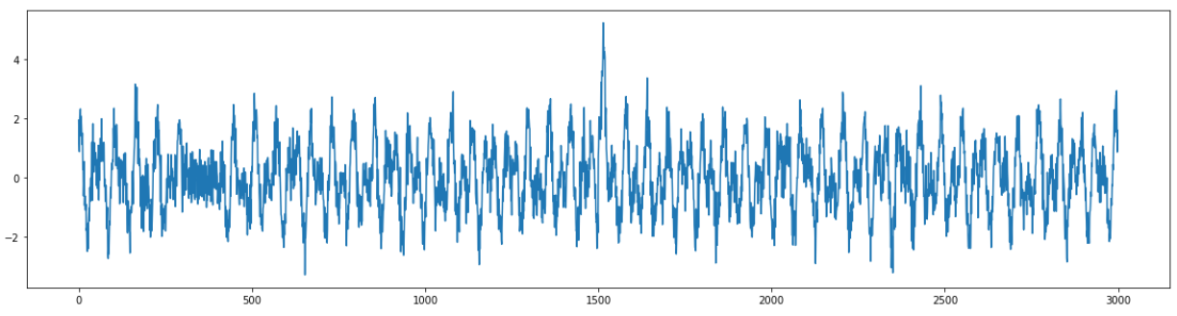
Anomaly Detection
Determines “rare” entities in data
Example: detecting faults in a product line during operation
Unlike classification or regression, anomaly detection models do not need labels to train – they only need the feature data
This task belongs to the Unsupervised Learning branch of Machine Learning
Time | Temperature
555 | 105
556 | 103
557 | 138
558 | 186
559 | 145
560 | 101
561 | 102
563 | 103
Anomaly
No
No
Yes
Yes
Yes
No
No
No
Only needs feature
data to learn
Generated by
trained model

Slide 11
Forecasting
Similar to regression, predict a target that has numeric types
However, usually involving a time dimension in the data – future values are predicted based on current and historical data
Examples:
Predict future stock prices
Predict future product sales
Like regression, this is a supervised learning task
Date | Open | High | Low | Close
1/4/2022 | 334.83 | 335.2 | 326.12 | 329.01
1/5/2022 | 325.86 | 326.07 | 315.98 | 316.38
1/6/2022 | 313.15 | 318.7 | 311.49 | 313.88
1/7/2022 | 314.15 | 316.5 | 310.09 | 314.04
1/10/2022 | 309.49 | 314.72 | 304.69 | 314.27
1/11/2022 | 313.38 | 316.61 | 309.89 | 314.98
NextClose
316.38
313.88
314.04
314.27
314.98
???

Slide 12

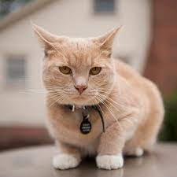

Image Analytics and Text Analytics
We focus on the mentioned tasks (classification, regression, etc.) however applied on image or text data
Image
Class
Dog
Cat
Cat
Comment
Love the product, will buy again, A++++++
Didn’t work. Returned. Not coming back.
The product is mediocre. Can temporarily use, but will replace
Rating
5
1
2

